Slide 1
Clustering Optimization objective

Slide 2
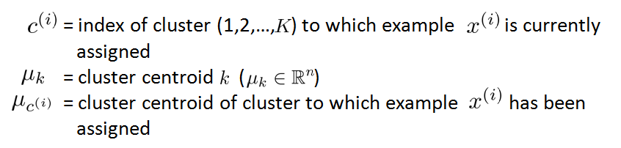
K-means optimization objective
Recall some of the parameters:

Slide 3
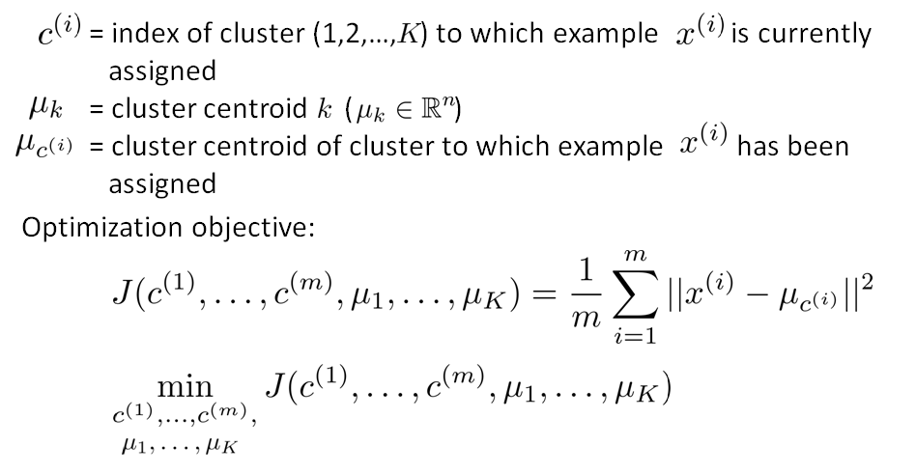
K-means optimization objective

Slide 4
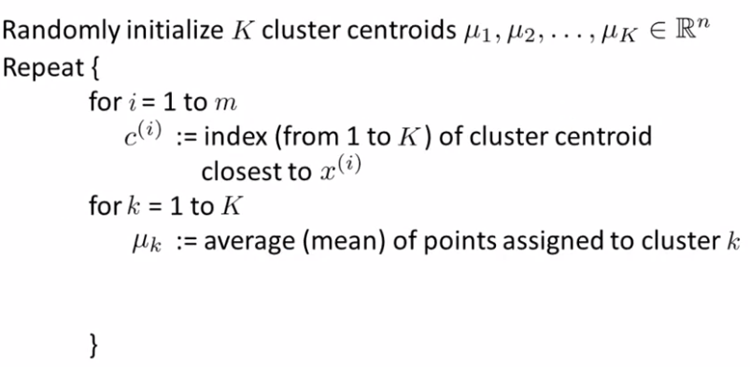
K-means algorithm
Cluster argument step
move centroid step

Slide 5
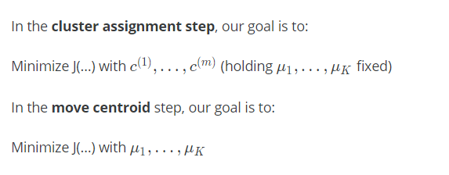
K-means algorithm

Slide 6
Random Initialization

Slide 7
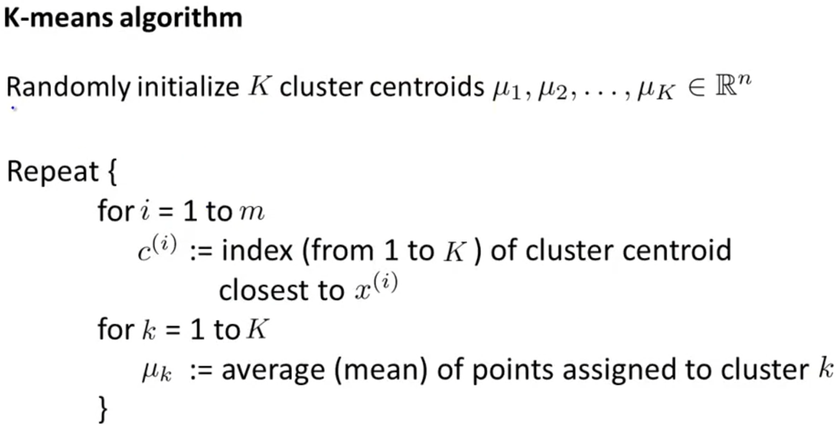
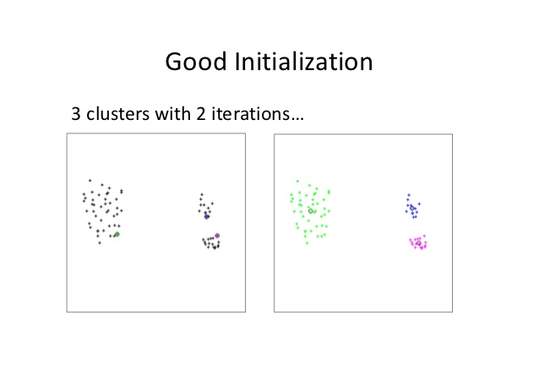

Slide 8
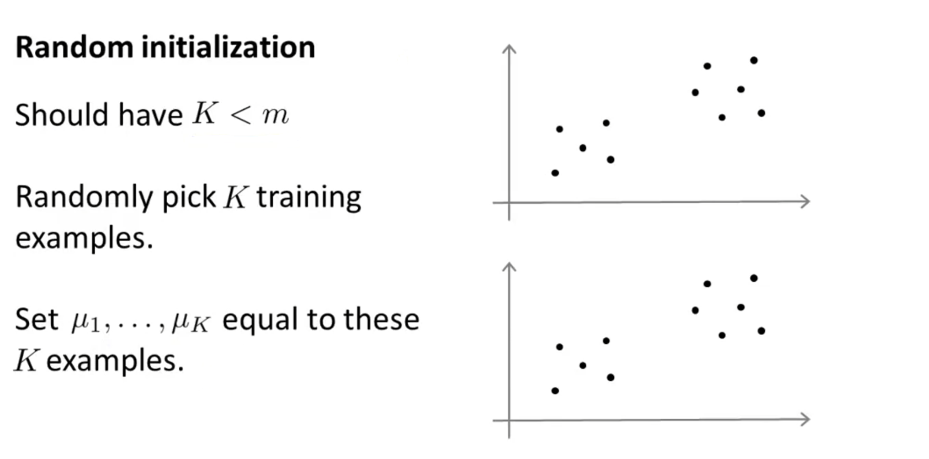

Slide 9
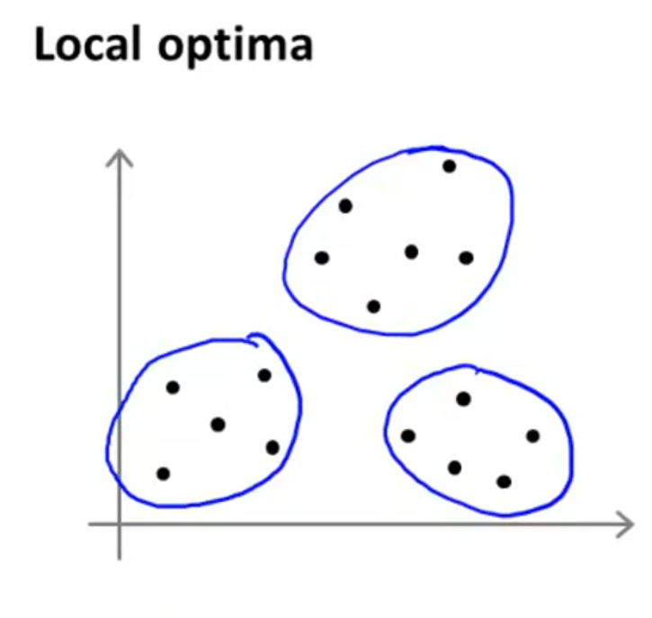
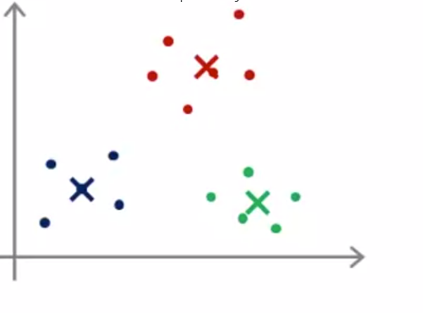
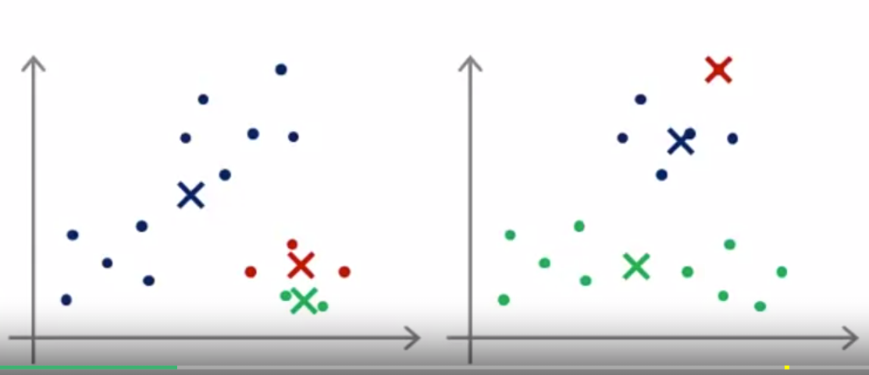

Slide 10
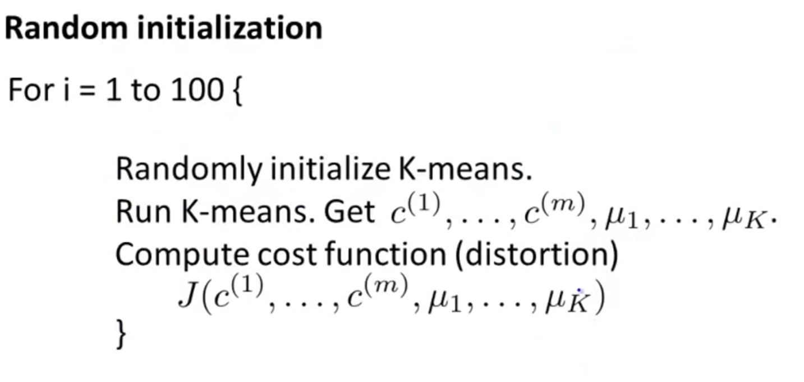
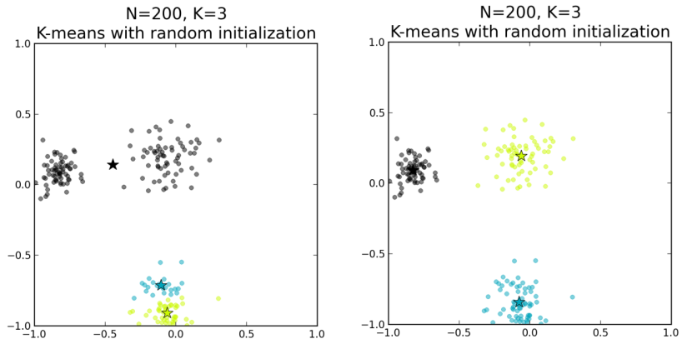

Slide 11
Choosing the number of clusters
Thang Nguyen

Slide 12
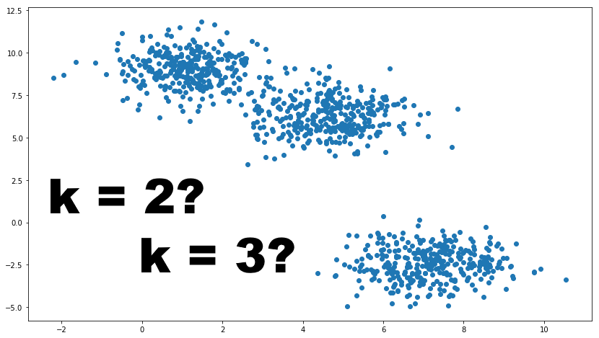
Choosing the value of K

Slide 13
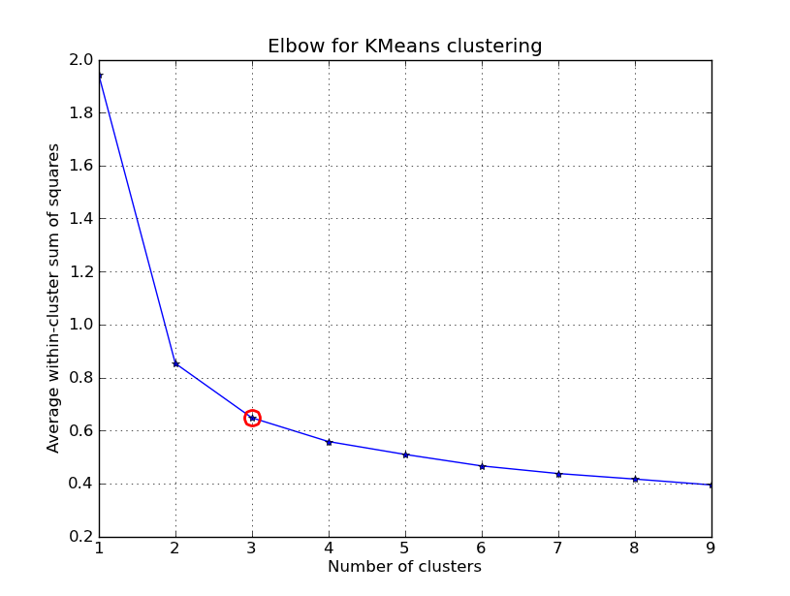
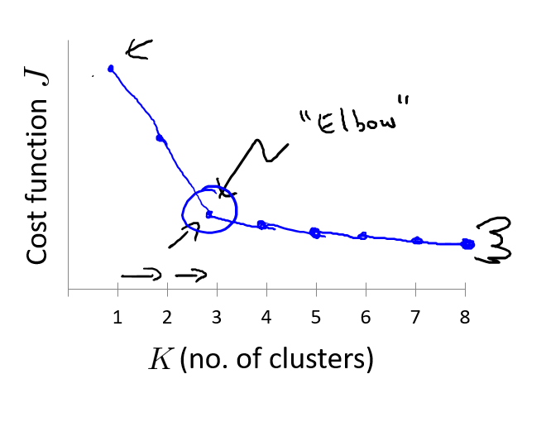
Elbow method

Slide 14
Choosing the value of K
Sometimes, you’re running K-means to get clusters to use for some later/downstream purpose. Evaluate K-means based on a metric for how well it performs for that later purpose.
E.g.
T-shirt sizing
T-shirt sizing
Weight
Weight
Height
Height

